Slide 1
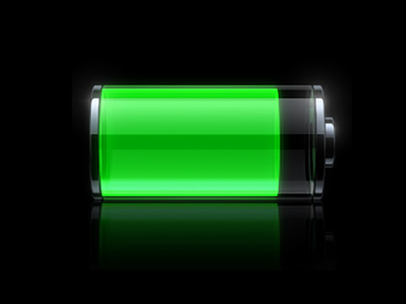

Electrical Power Subsystem

Slide 2
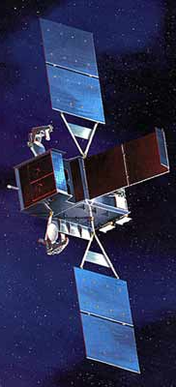
AOCS 150 W
propulsion 100 W
Payload 200 W
CDHS 100 W
TOTAL 550 W

Slide 3
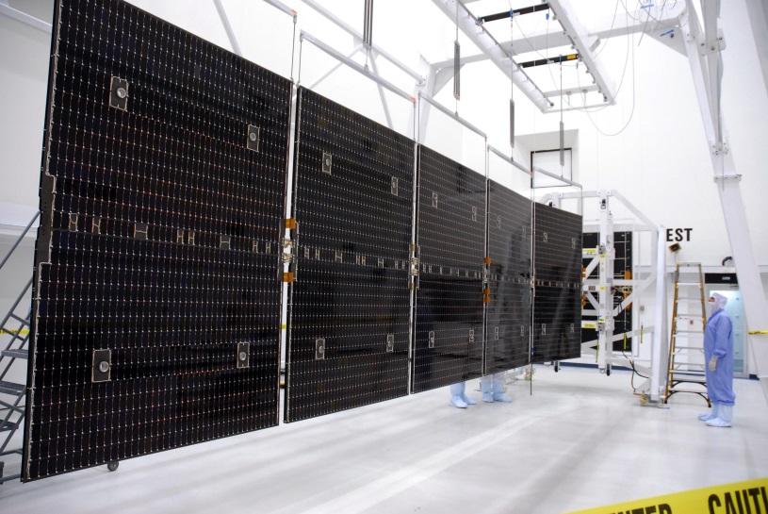
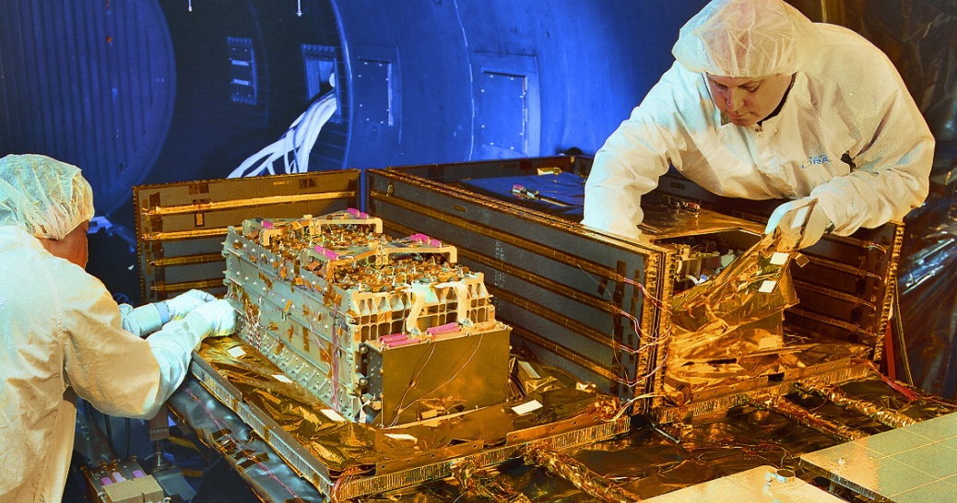
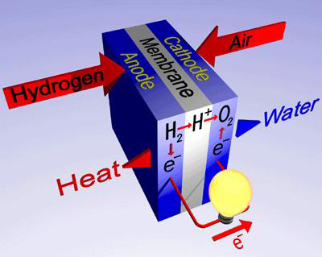
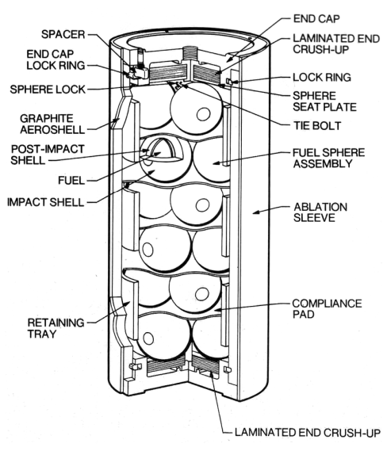

Slide 4
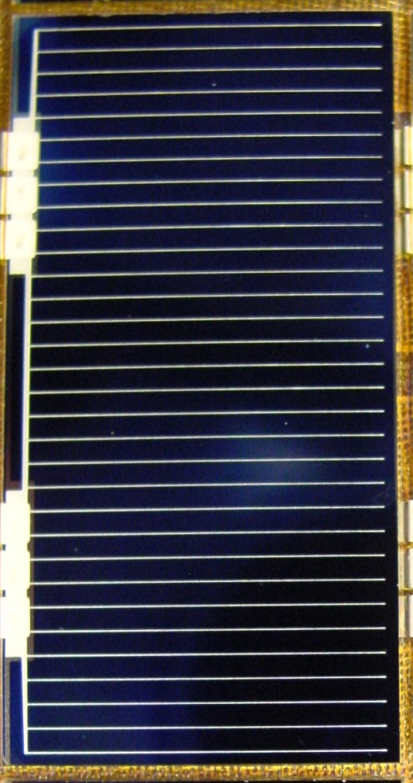
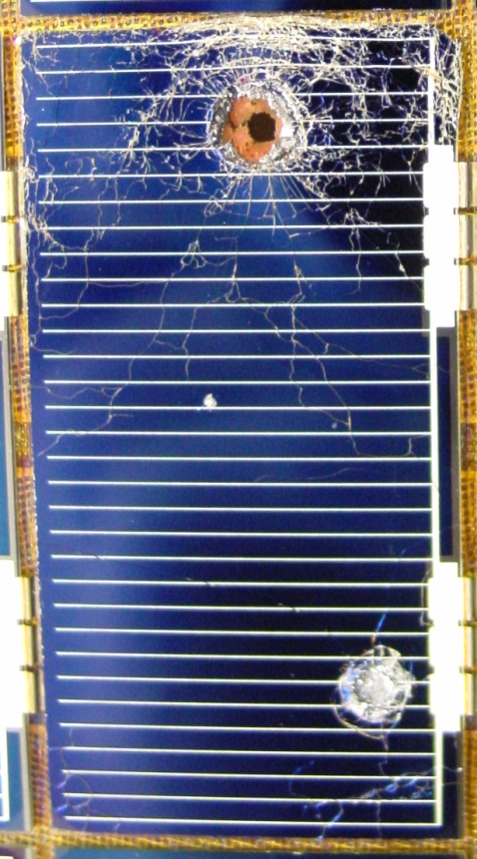
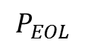
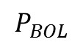
$$P_{BOL}$$
$$P_{EOL}$$
Mission Life

Slide 5
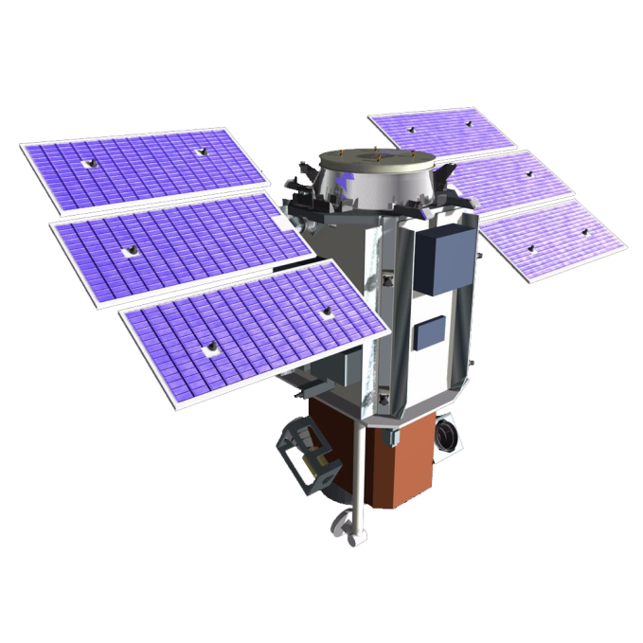

Slide 6
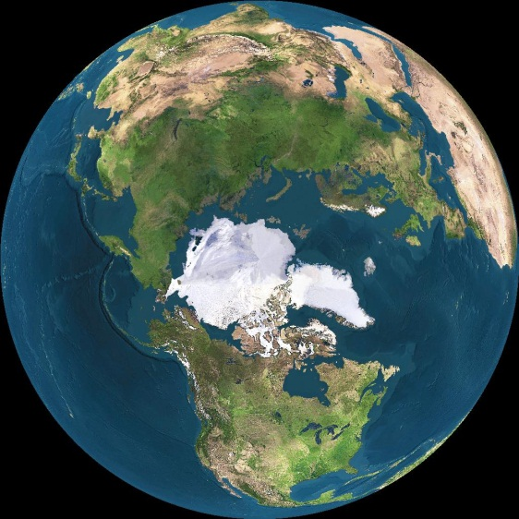
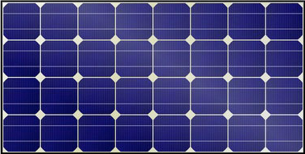
subsystems + payload
battery

Slide 7


Time of Eclipse (TE)
LEO
MEO

Slide 8

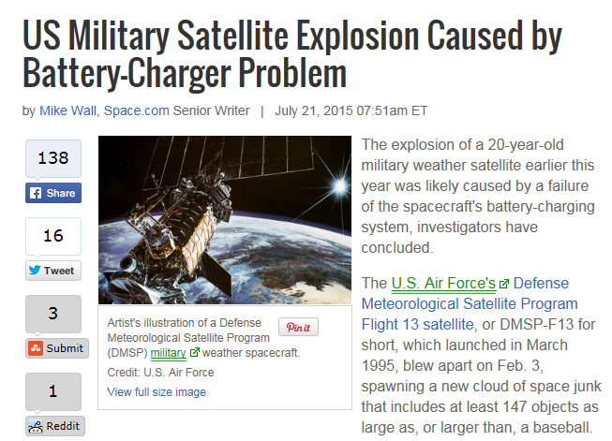
Battery Capacity
DOD

Slide 9
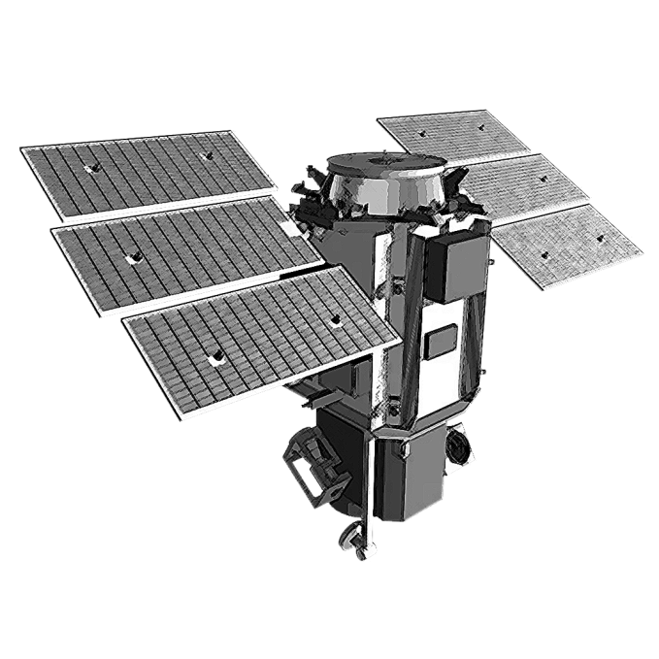
In Class Exercise 1
A spacecraft is carrying a payload requiring 500 W that will be turned on in the daytime only. The bus requires 120 W and runs continuously. If a spacecraft is in circular orbit at an altitude of 1000 km around the Earth, what is the power requirement from the solar panels (W)?
What is the total amount of energy the solar cells must generate each orbit while in the Sun in Watt-hrs?

Slide 10
In Class Exercise 2
A spacecraft is carrying a payload requiring 500 W that will be turned on in the daytime only. The bus requires 120 W and runs continuously. If a spacecraft is in a 1000 km circular orbit around the Earth, and if the maximum depth of discharge for its battery is 30%, what battery capacity do we need?
If we have a battery that can provide 250 W-hrs, what is our battery capacity margin?

Slide 11
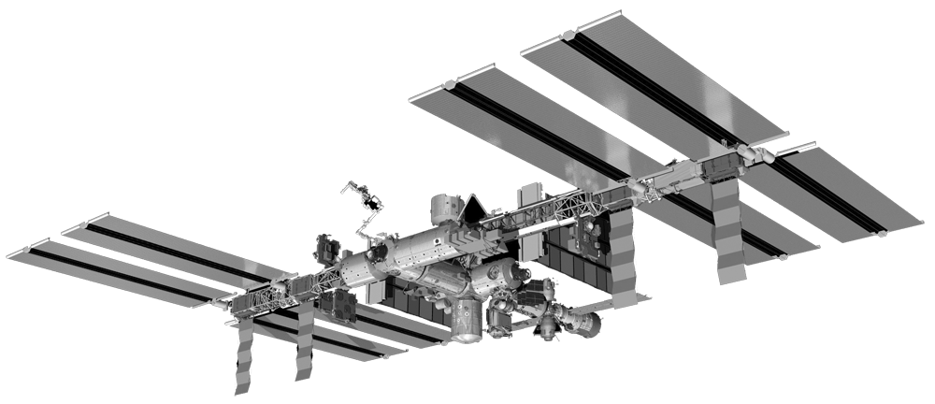
In Class Exercise 3
The International Space Station can expose 2000 square meters of solar arrays to the Sun. The arrays are designed to track the Sun, in order to maximize the amount of power produced. The efficiency of the arrays is 29%. Assuming an incidence angle of 10 degrees, how much power do they produce?

Slide 12
In Class Exercise 4
If the ISS solar arrays degrade at a rate of 3% per year, how much power will they produce in 5 years?

